Slide 1
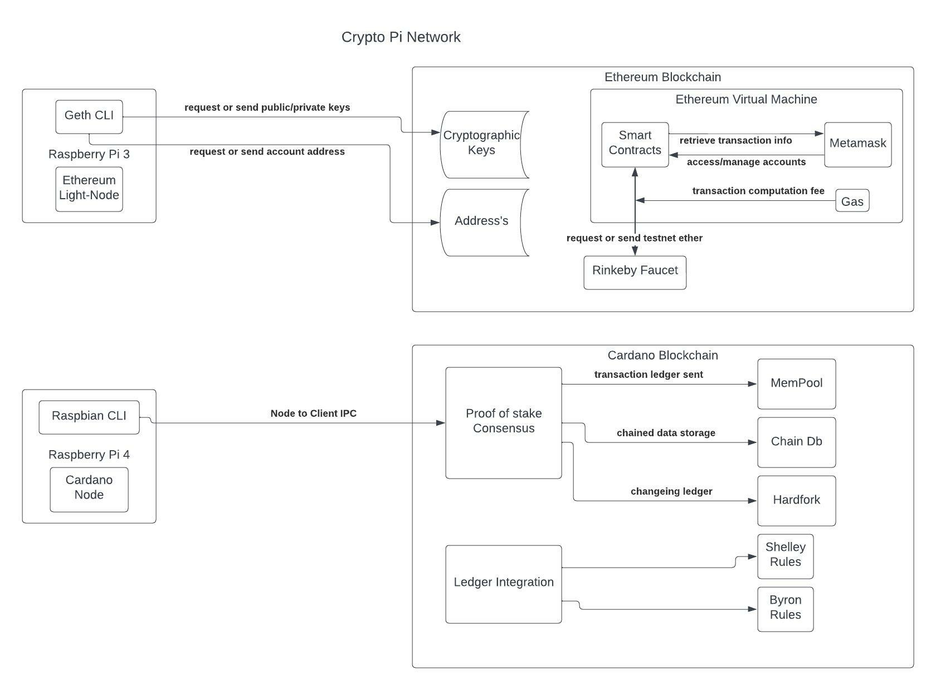
Crypto Pi NetWork

